Slide 1
Spotify Review
Consumer Sentiment Analysis
MKTG 720
By- Aidevo Longe, Anastasiia Kolomytseva, Ayushi Pandey

Slide 2
TABLE OF CONTENTS
01
02
03
04
05
06
Introduction
Data Collection
Cleaning Data
Modeling
Data Analysis
Conclusion

Slide 3
01
Introduction

Slide 4
Spotify
Spotify is one of the largest streaming service providers with over 422 million active monthly listeners. In order to grow and maintain their user base they are constantly updating the platform.
Spotify can utilize reviews during times of software updates in order to see if users are enjoying the update or need to make software patch.
Research Question:
Can machine learning models predict user satisfaction based on review sentiment before and after Spotify updates?
Research Question:
Can machine learning models predict user satisfaction based on review sentiment Spotify launches updates?

Slide 5
02
Data Collection and Labeling

Slide 6
Data Collection
The Spotify reviews were taken from the Google Play store between January 1, 2022 and July 9, 2022.
During this time Spotify introduced multiple new software updates like Blend, Karaoke mode, and introduced CTA cards for Podcast.
While using the app users are prompted to rate the app and leave a review.
Dataset: ~61,500 reviews
*Data from Kaggle

Slide 7
Labeling (Track 3)
Each group member was assigned 400 Spotify Reviews, for 1,200 manually labeled reviews
Each group member read each review and assigned a sentiment based on the content and the app rating from 1 to 5
Positive
Negative

Slide 8
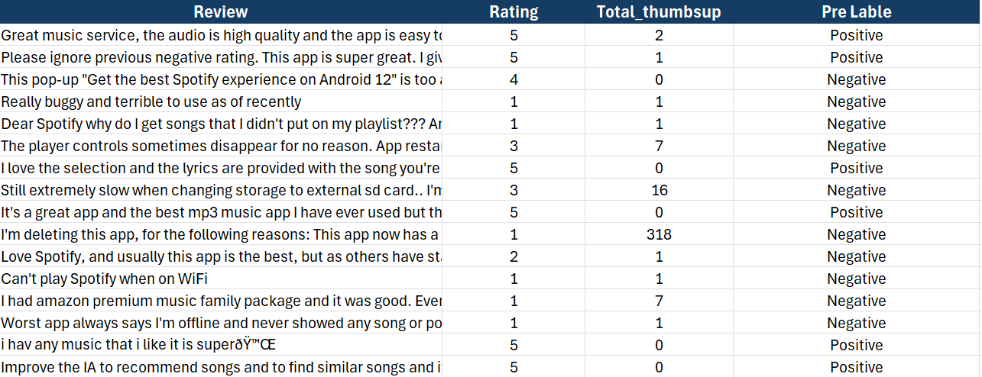

Slide 9
03
Cleaning Data

Slide 10
Data Cleaning
We used our own text normalizer to clean pre-labeled data using the following functions:
Lower case
Expanding contractions
Removing tags
Removing special characters
Removing stopwords
Notes:
Data preprocessing is the key factor for the effective analysis, ensuring clean, reliable data for accurate predictions. We used our own castomised library to normalize to prepare the text data for further analysis, the normalizer included the following functions, which is lowercase, expanding contractions, eliminating tags, filter out stopwords. In our case we experimented with functions and didn’t notice significant affect on the model results.

Slide 11
04
Data Modeling

Slide 12
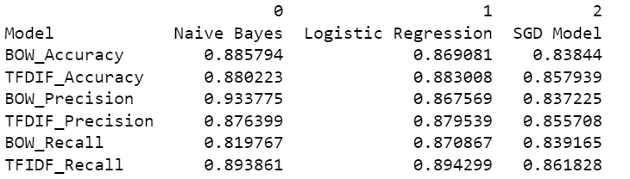
Data Modeling
Transformed textual data into numerical feature vectors using Bag of Words (BoW) and TF-IDF.
Trained three models (Naive Bayes, Logistic Regression, SGD Classifier) on both BoW and TF-IDF features
Computed accuracy, precision and recall scores for each model by comparing their predictions to the ground truth sentiments
Utilized BoW with Naive Bayes for modeling
Notes:
Transformed textual data into numerical feature vectors using Bag of Words (BoW) and TF-IDF as vectorizors.
Employed the BoW approach in conjunction with the Naive Bayes algorithm for modeling.
Trained three models (Naive Bayes, Logistic Regression, SGD Classifier) separately on both BoW and TF-IDF feature sets.
Computed accuracy scores for each model by evaluating their predictions against the ground truth labels.

Slide 13
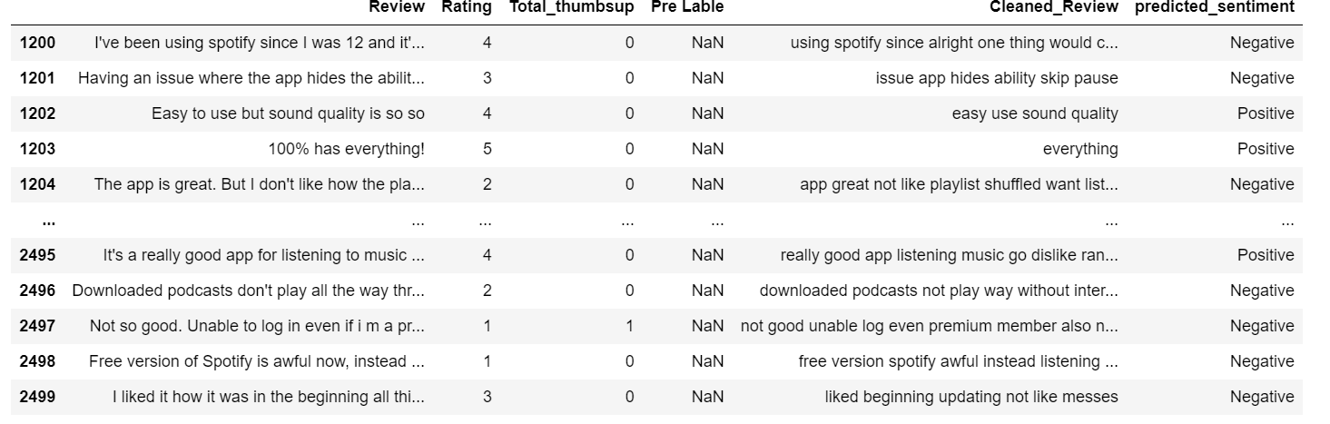
Sentiment Prediction
Selected the trained Naive Bayes model with the highest accuracy and used it to predict the review sentiments for the rest of dataset.
Normalized the reviews using our built normalizer library.
Predicted the sentiments by applying the trained model.

Slide 14
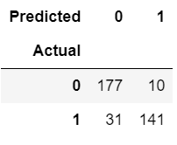
Confusion Matrix
From the confusion matrix, we can see that the model correctly predicted 177 instances of negative sentiment (0) and 141 instances of positive sentiment (1).
However, it misclassified 10 instances of negative sentiment as positive and 31 instances of positive sentiment as negative.

Slide 15
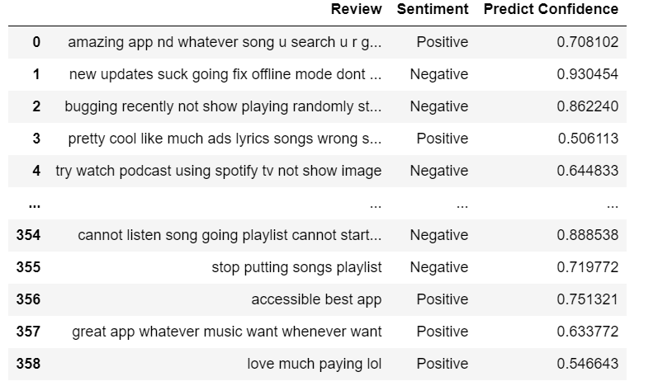
Predicted Score
The "Predict Confidence" column shows the highest probability among all sentiment classes for each review, indicating how confident the model is in its prediction.

Slide 16
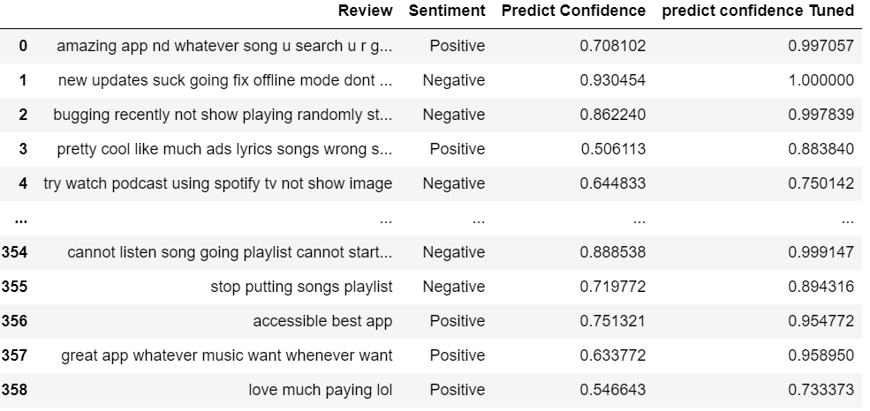
Tuning the Model

Slide 17
05
Data Analysis

Slide 18
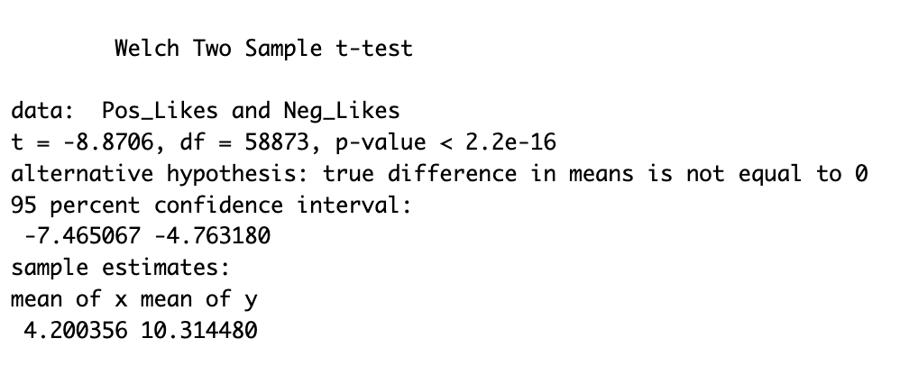
Quantitative Data Analysis
There is a significant difference in the number of likes between positive reviews negative reviews.

Slide 19
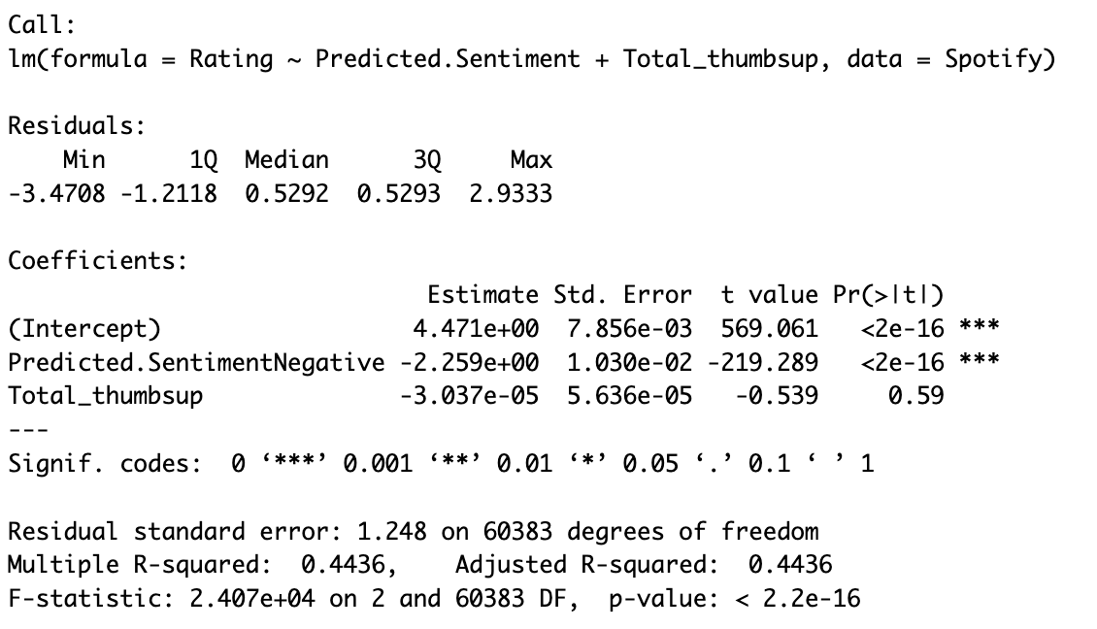
Data Analysis
•Dependent: Rating
•Independent: Sentiment, Total Thumbs Up
Negative Reviews: Significantly affects Rating, with negative sentiment decreasing the rating by 2.259 points
The model explains 44% of the variance in the ratings
p-value
Notes:
The results of a regression analysis suggest that the model was significant (F(2, 60383) = 24,070, p < .01), with rating explaining 44% of the variance in negative reviews. Specifically,negative reviews had a significant influence on ratings.

Slide 20
Conclusion
Sentiment Analysis | Impact on App Ratings | Actionable Insights
Uncovered significant differences between positive and negative reviews. Negative reviews received more likes on average, indicating stronger resonance among users. | Regression analysis revealed negative reviews have a considerable negative effect on app ratings. Emphasizes the importance of addressing user concerns promptly. | Actively monitor user feedback to enhance user experience. Incorporate user feedback into product development cycles for continuous improvement.
Notes:
These takeaways highlight the importance of user feedback in maintaining a compelling and satisfying user experience for Spotify's global user base.

Slide 21
THANKS!
Do you have any questions?

